Slide 1
Multi-Satellite Fire Detection Composite
CSB Meeting
1 Jun 2020

Slide 2
Progress Update
Building up library of training data
Improving H-8 Hotspot Product with ML
Himawari-8 GB hotspots
Multi-Satellite Fire Detection Composite

Slide 3
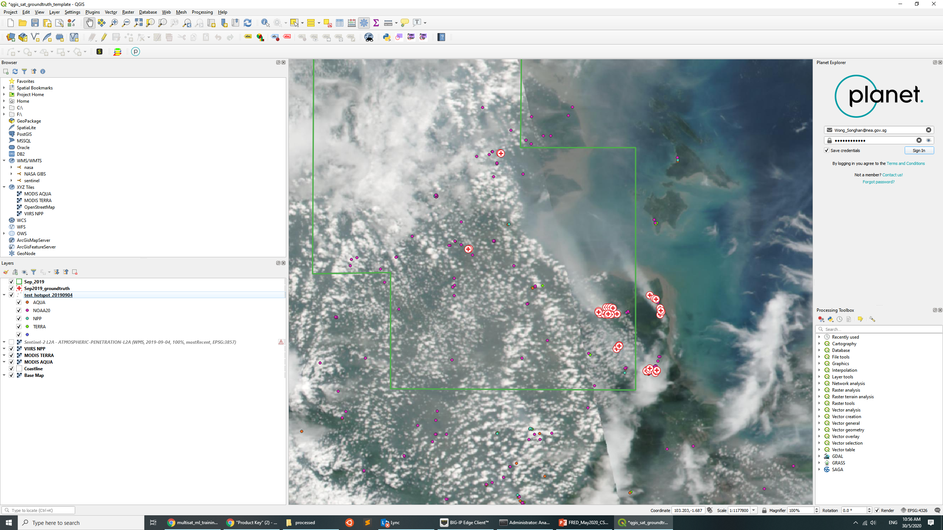
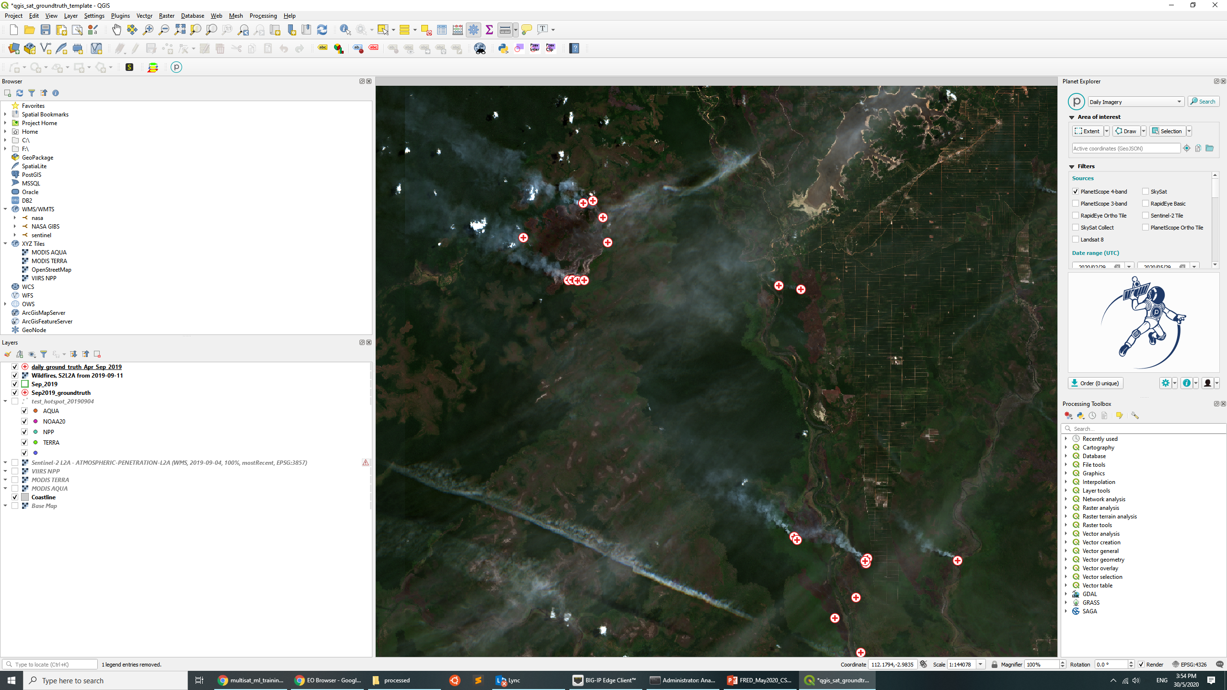
Preparing Training Data
Identify fire hotspots based on daily polar satellite imagery
60 days of data for Apr 2019 and Sep 2019
Sentinel-2, Planet, TERRA, AQUA, Suomi-NPP
~14,000 hand-labeled data points ! Kudos to Effy for helping out with big chunk of work.
Hand-labelled ground truth

Slide 4
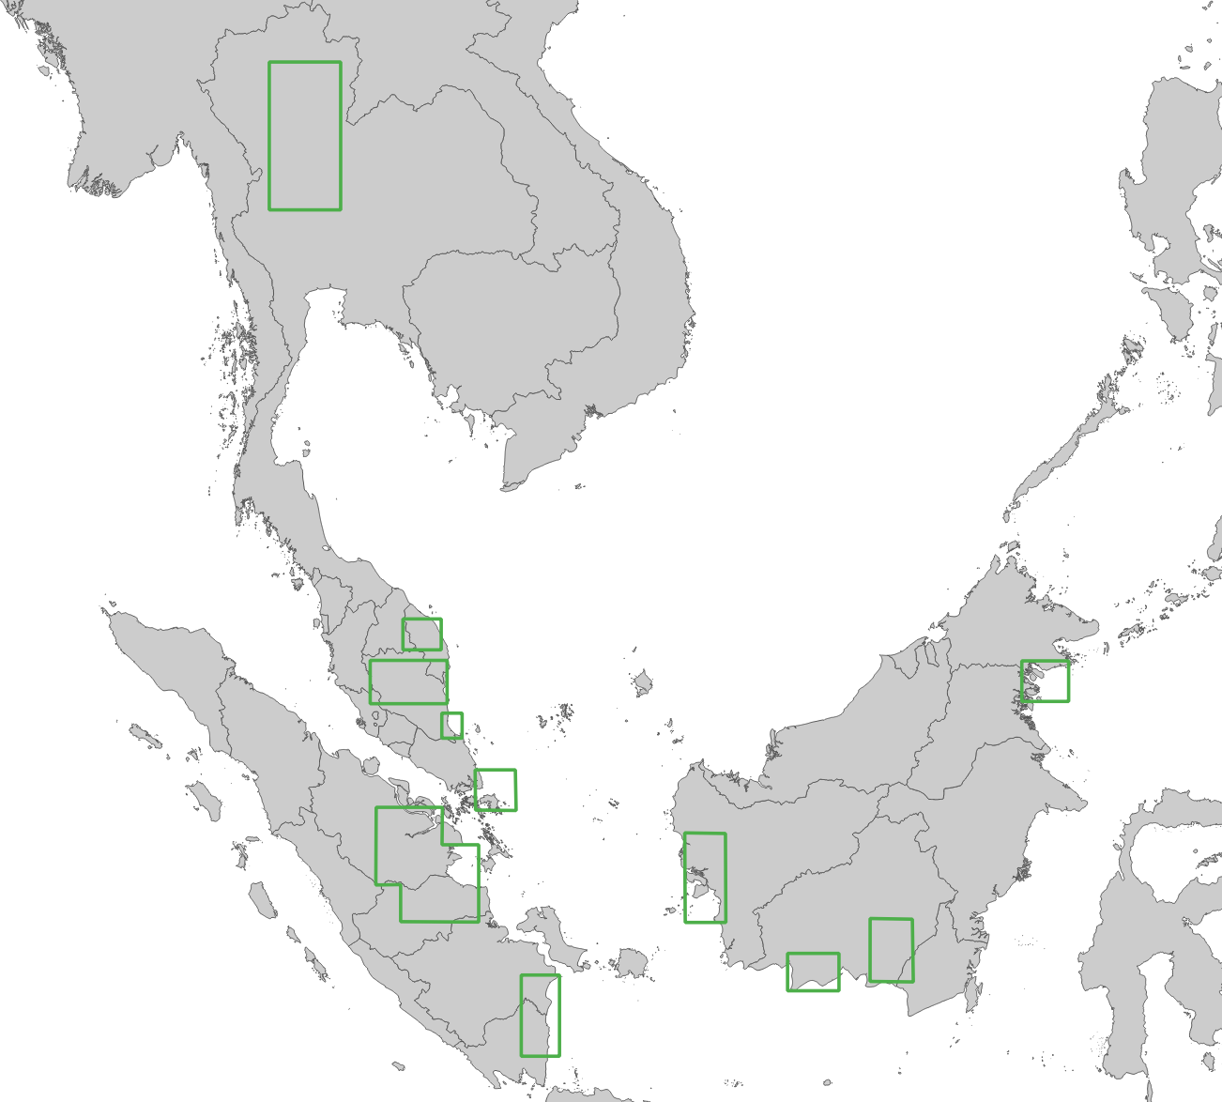
Area of Interest
Dataset has a bias for southern ASEAN region
Fire-prone areas
Prone to sun glint & false alarms
Fire-prone areas

Slide 5
Improving H-8 Hotspot Product with ML

Slide 6
Motivation
Earlier experimentation with sun glint filter showed promising results in lowering false alarm detections
Can we improve product performance further using ML ?
Hotspot Data Features
Features | Description
IR3.9 | Shortwave IR (SWIR) Longwave IR (LWIR) Difference between SWIR and LWIR
IR11.2
∆T, IR3.9 – IR11.2
Mean of IR3.9, IR11.2, ∆T of neighbouring pixels | Part of contextual algorithm
Std Dev of IR3.9, IR11.2, ∆T of neighbouring pixels
Reflectance of VIS 0.64 um and 0.86 um | Presence of sun glint
Sun glint angle

Slide 7
Training Data Preparation
Use training data (14,000 points)
Each fire label is assumed to be valid from 0230 – 0730 UTC
Buffer of 1 km radius
Apply standard scaling
Assess if a hotspot was a hit/false alarm for every 10-min interval
Missed detections only counted once
Overpenalise if count every 10 mins as H-8 hotspot has tendency to miss a lot of small fire detections

Slide 8
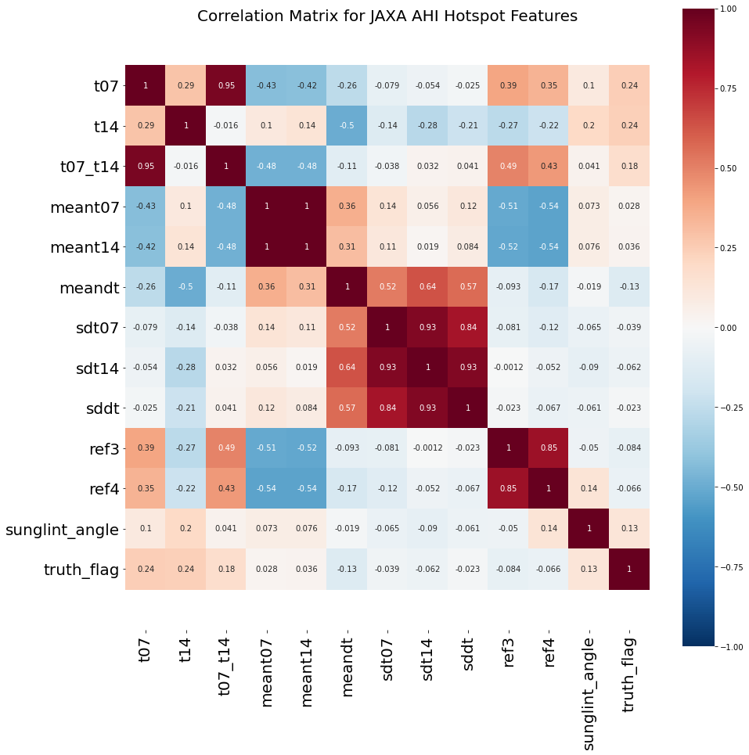
Correlation Matrix
How hot the fire is ?
How hot the fire is as compared to neighbouring areas?
Presence of sun glint

Slide 9
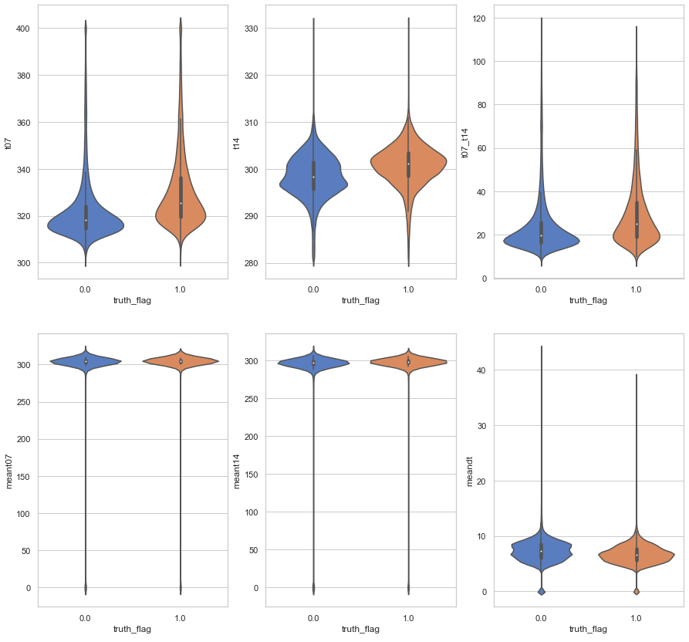
Violin Plot for Data Exploration
No clear separation of fire vs non-fire looking at each variable individually
Multivariate and non-linear

Slide 10
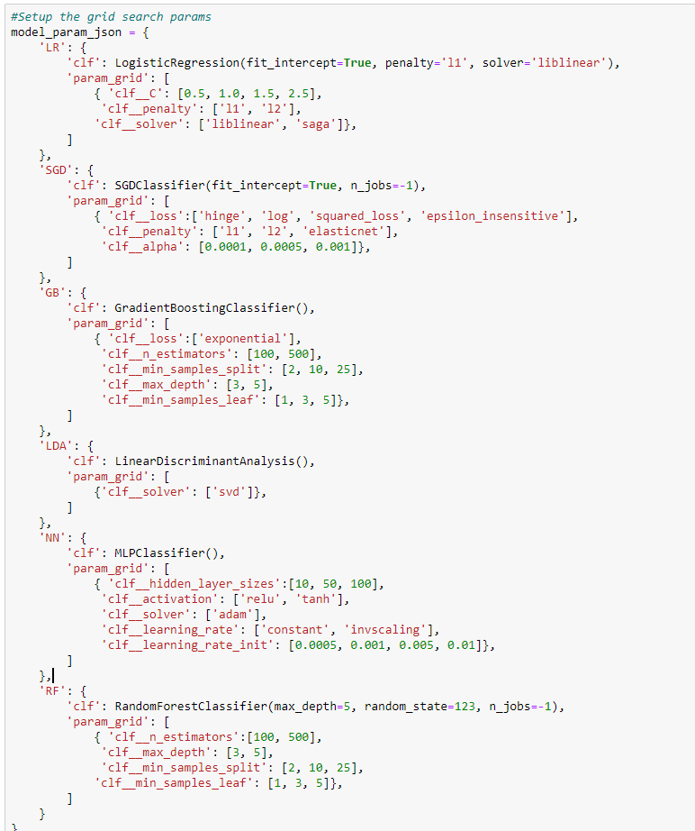
Model Selection
Run a grid search (brute force) to find the best model & parameters
Logistic Classifier
Stochastic Gradient Classifier
Random Forest Classifier
Gradient Boosting Classifier
Linear Discriminant Analysis
Neural Network

Slide 11
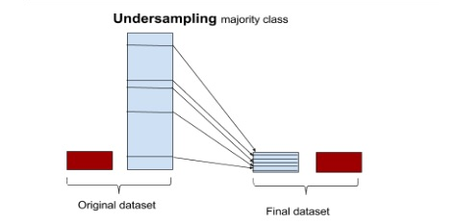
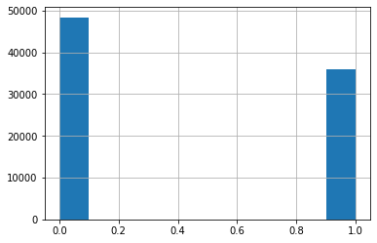

Model Training & Cross Validation
Train/test data split 80:20
Use undersampling to create balanced training dataset
More false alarms than real/missed detections
Run k-fold cross-validation (k=5) to find the best parameter for each model
False alarm
Real Fire

Slide 12
Results
Results are presented in two stages:
Part A: Exclude missed detections that were not detected by JAXA Himawari-8 hotspot. Not possible for ML to pick up anyway. We’ll look at this result for the purpose of model tuning & selection.
Part B: Model performance based on entire ground truth including missed detections.

Slide 13
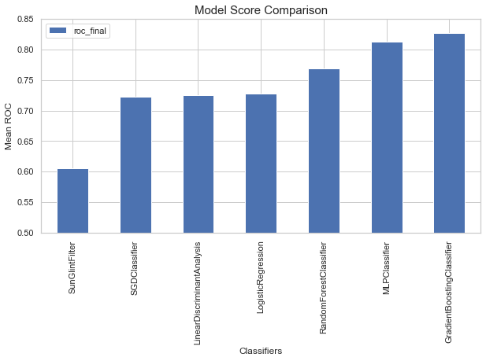
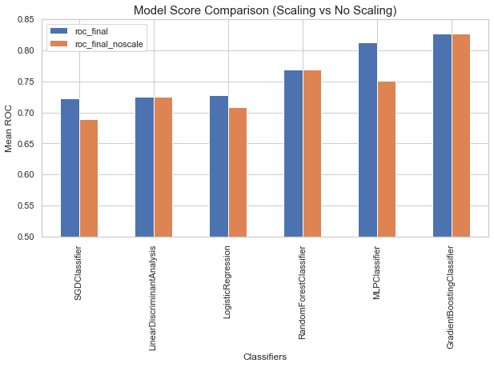
Results (Part A) for Model Selection
Gradient Boosting Classifier has the best performance (~ROC of 0.83)
Significant improvement over sun glint filter
No scaling required

Slide 14
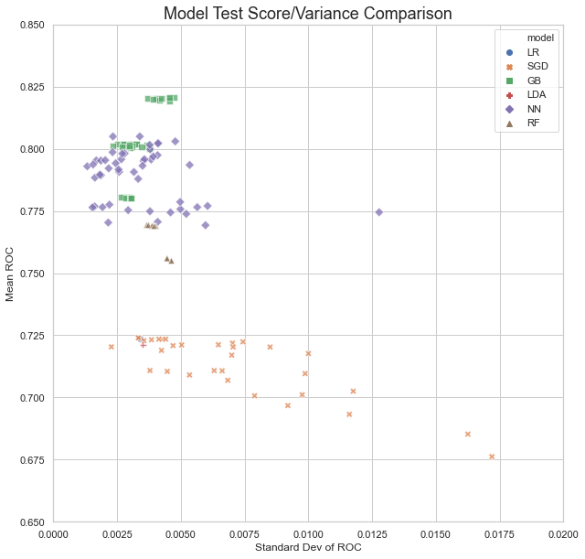
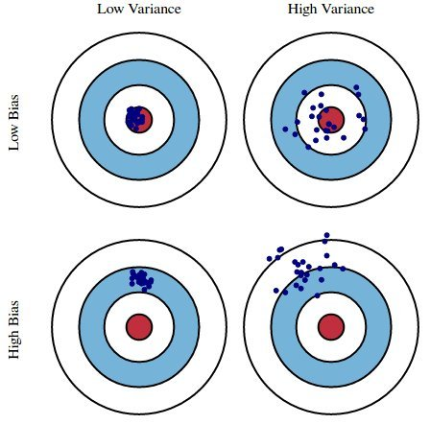
Results (Part A) for Model Selection
Gradient Boosting classifier has high score and low variance
Less prone to overfitting and may perform better in general cases (e.g other months, regions)
Gradient Boosting classifier

Slide 15
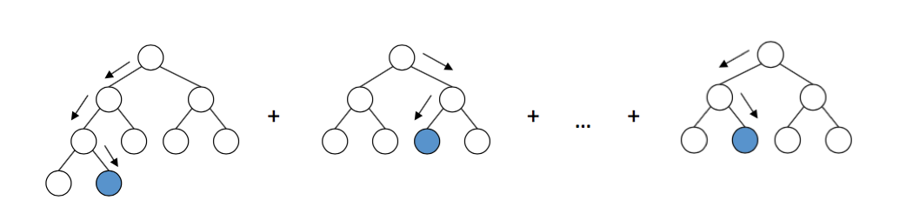
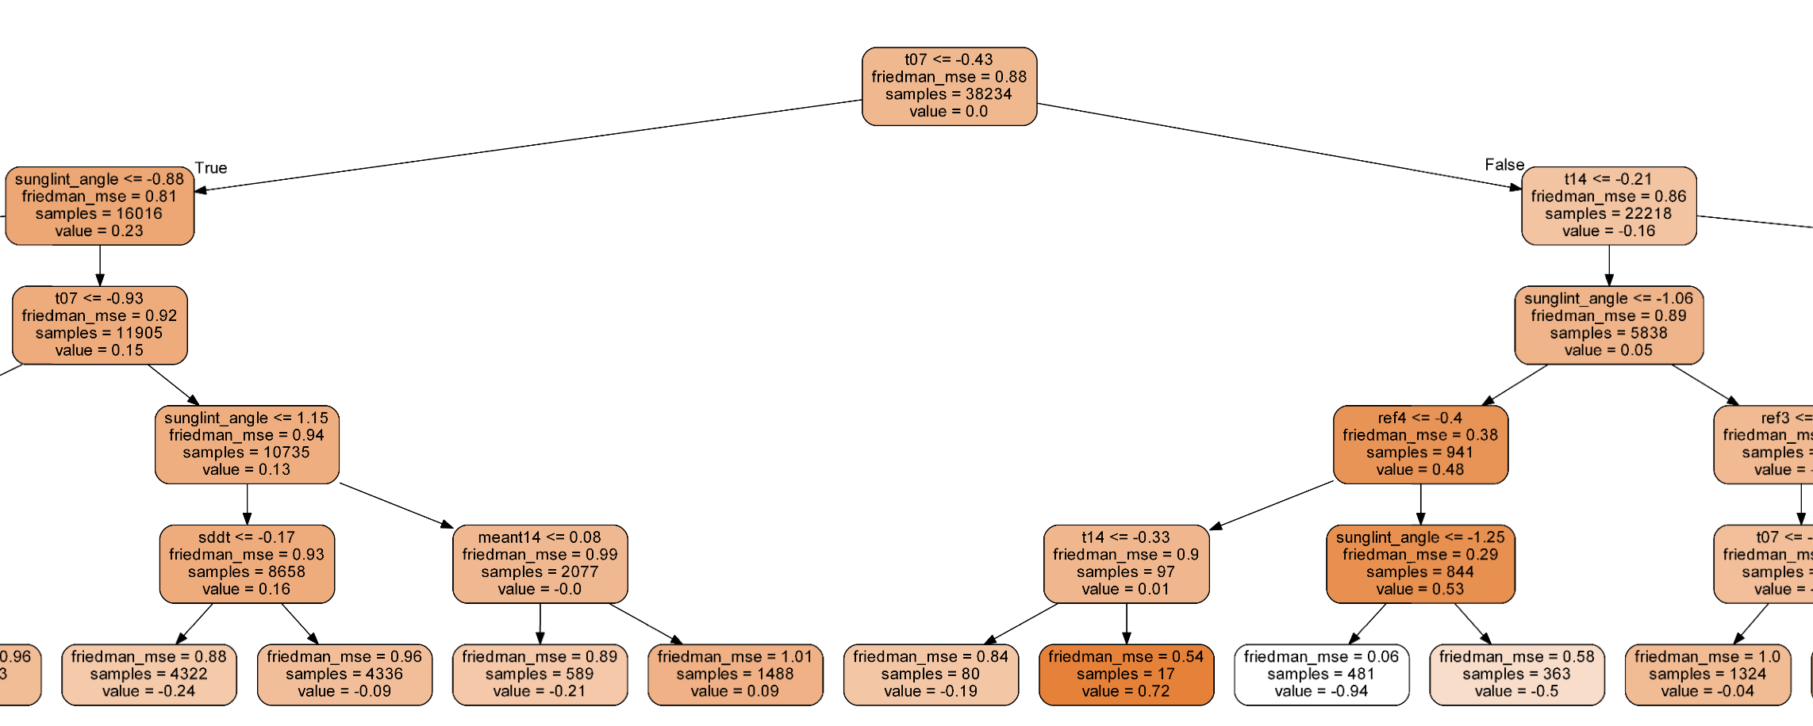
What is Gradient Boosting (GB)?
Ensemble approach to make use of many simple decision trees
Similar to random forest but differ in how the trees are built
This GB model is comprised of 500 ensemble members

Slide 16
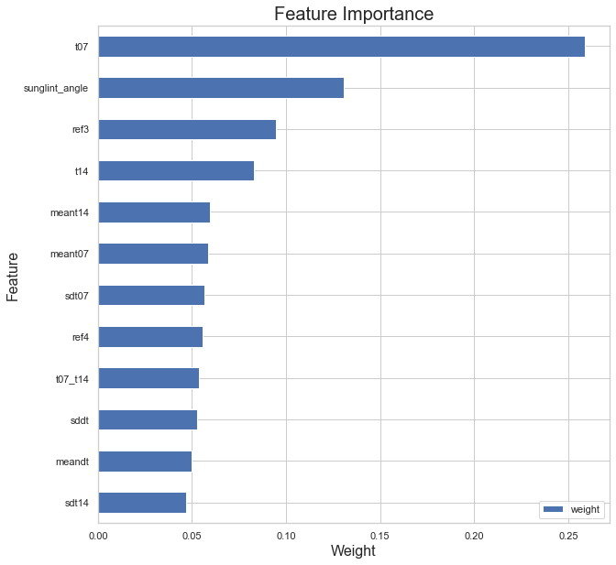
Results (Part A): Feature Importance
Gradient Boosting classifier thinks the absolute temperature and sun glint angles are the most important features in determining if a hotspot was real or not

Slide 17
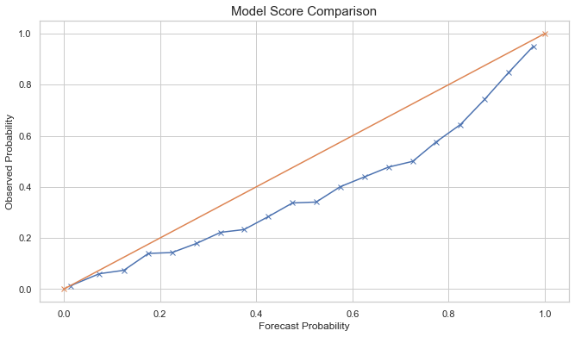
Results (Part A): Reliability of Model Forecast Probability
Reliability of model forecast probability is reasonably reliable, with some bias for overforecast

Slide 18
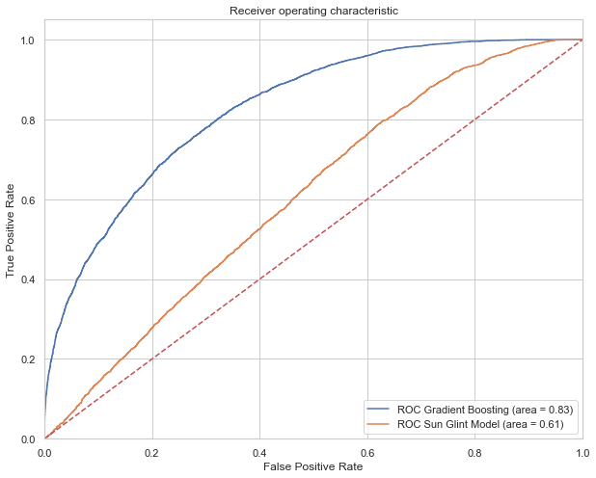
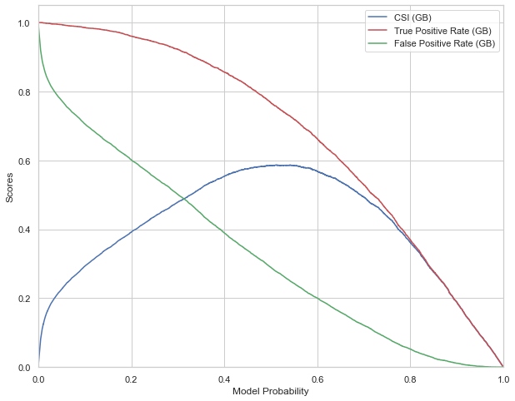
Results (Part A) for Model Selection
Best probability threshold to determine a hotspot
~50%
Gradient Boosting: CSI: 0.58, Hit Rate: 75%, FAR: 27%
Baseline (sun glint filter): CSI: 0.4, Hit Rate: 55%, FAR: 40%

Slide 19
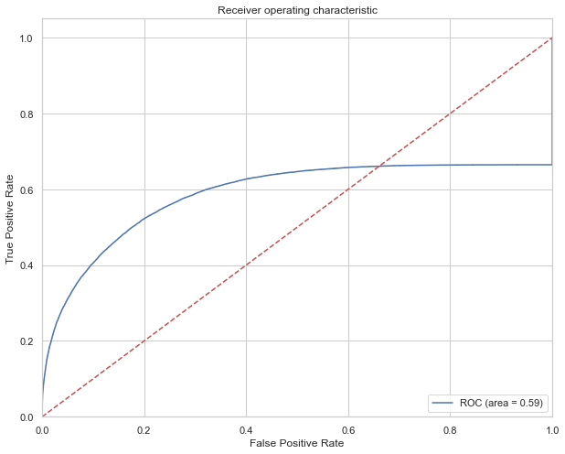
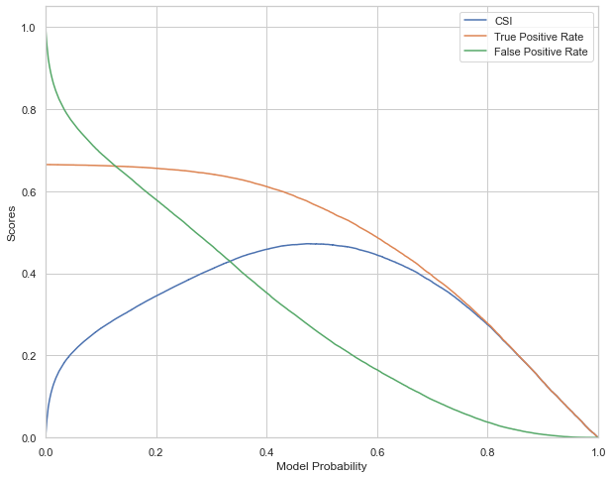
Results (Part B) Final Score
Drop in CSI and Hit Rate due to the inclusion of missed detections
Gradient Boosting : 0.47 , Hit Rate: 57%, FAR: 27%
Relative performance is the same as result A

Slide 20
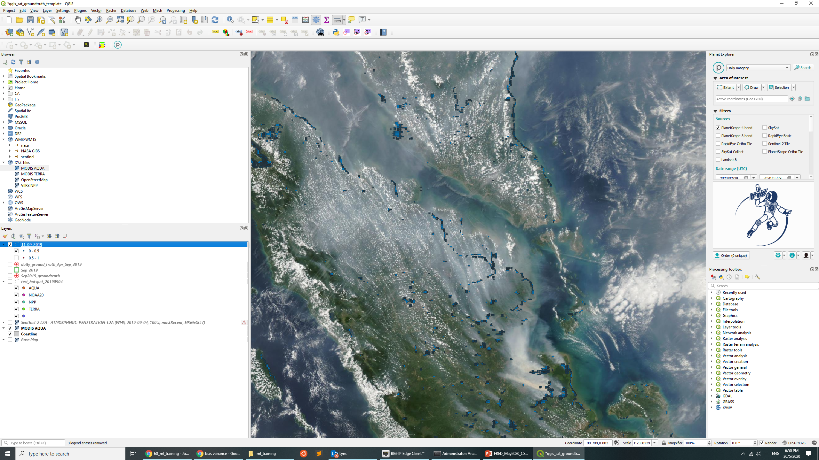

Product Example
Example below shows the of Himawari-8 GB hotspots (00-0950 UTC) on 11 Sep 2019
Himawari-8 GB hotspots with probability < 50%
Himawari-8 GB hotspots with probability >= 50%
11 Sep 2019

Slide 21
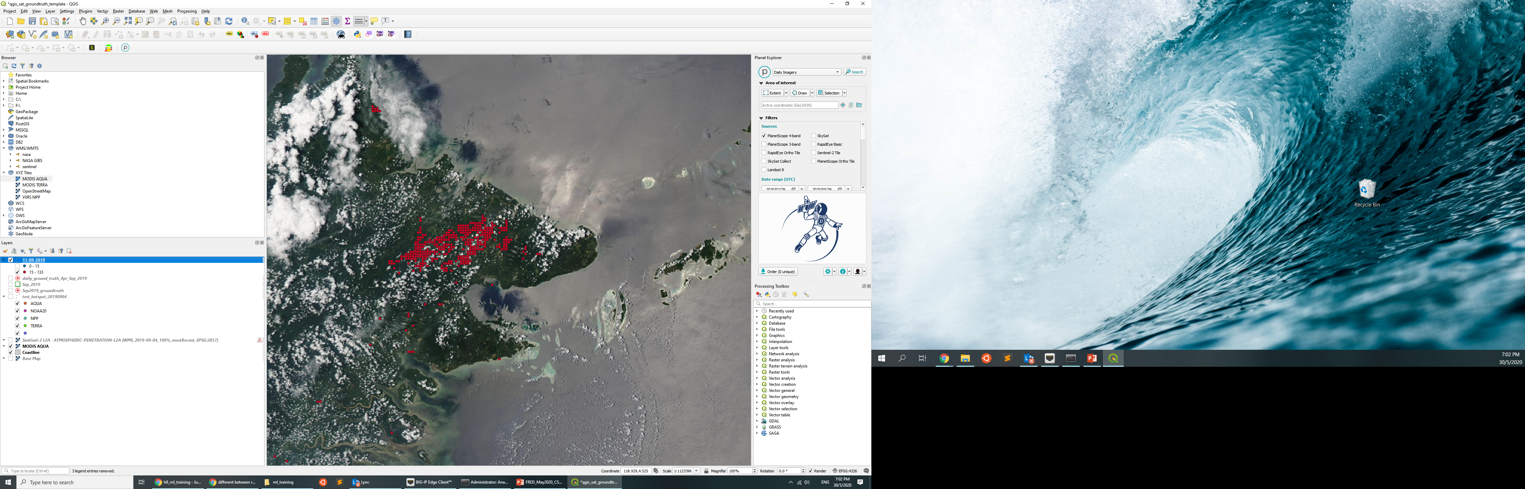

Product Example
Superior performance over baseline sun glint filter
Only sun glint filter
Himawari-8 GB hotspots with probability >= 50%
11 Sep 2019

Slide 22
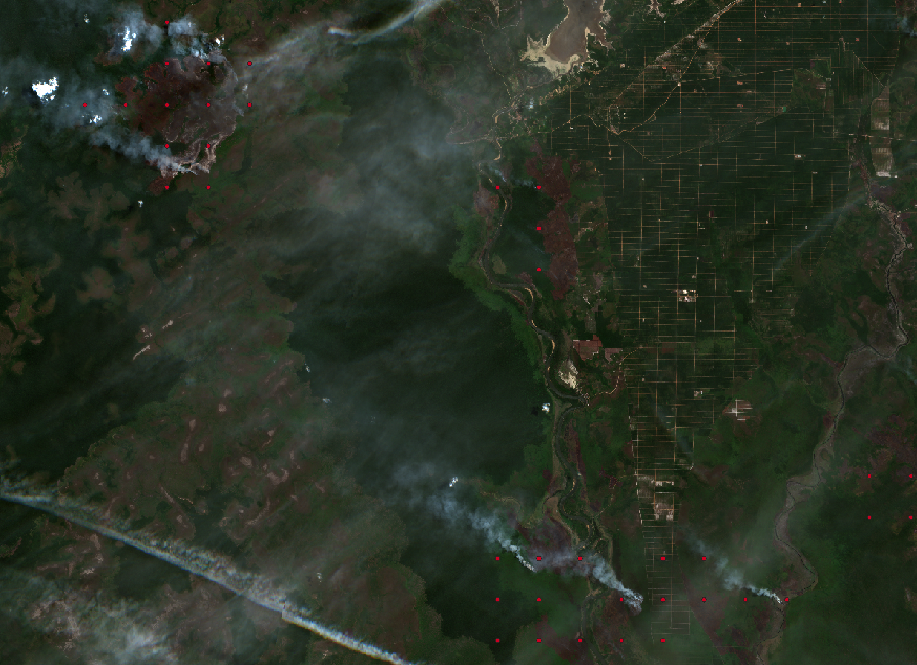
Product Example
Capable to detecting small fires without the downside of false alarms suffered
Sentinel-2

Slide 23
Summary
Significant improvement in detection performance with the use of machine learning techniques
>30% improvement in model score from baseline version (sun glint filter)
Hand-labelled training dataset by expert is extremely important!
Time-consuming but worth the effort

Slide 24
Multi-Satellite Fire Detection Composite
FUSIUN

Slide 25
Progress Update
Continuation of earlier work but
Expanded training/verification data with the new Apr and Sep 2019 dataset
Replaced original Himawari-8 JAXA hotspot with the improved version

Slide 26

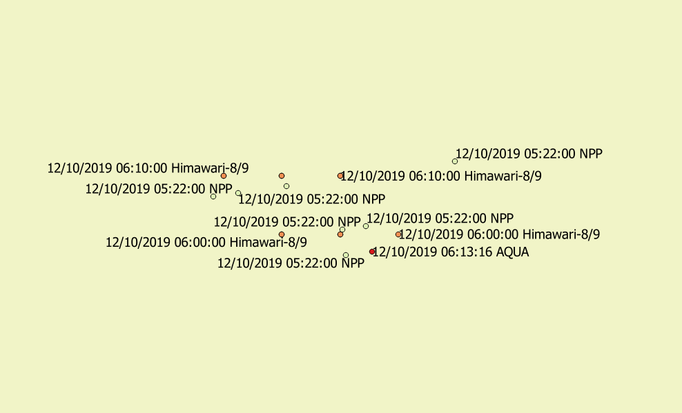
Temporal Aggregation
11.30 am
1 pm
2 pm
2.30 pm
TERRA
AQUA
NOAA-20
Suomi-NPP
Himawari-8
Himawari-8
Himawari-8
8 am
12.50 pm
3 pm
Aggregate fire hotspot detected within a certain observation window period
Observation period used:
00:00 – 08:30 UTC
Aggregated Hotspots (00 – 09 UTC)

Slide 27
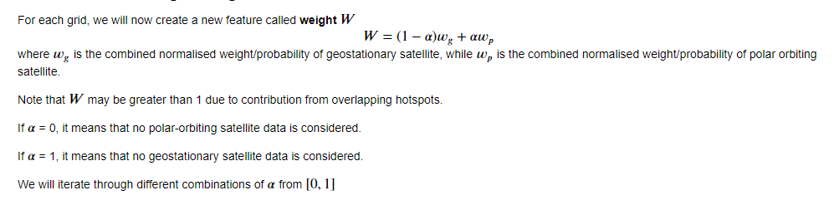
Combining Geostationary and Polar Hotspots
First, we create a combined Weight using the Himawari-8 GB probability and Polar Orbiting Satellite Confidence Levels
Machine learning logistic regression model is then applied

Slide 28
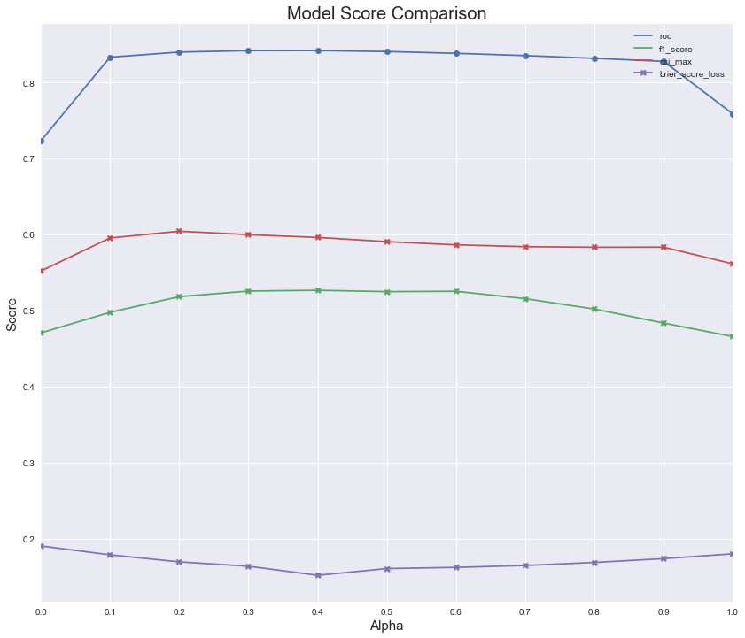
Model Score
Choice of Alpha isn’t too sensitive, plateaus around 0.4 – 0.6
Combination of both geo and polar hotspots improves the overall detection performance
Chosen alpha = 0.6 (highest F1-score)
Combined
N20, NPP, TERRA, AQUA only
H8 GB only

Slide 29
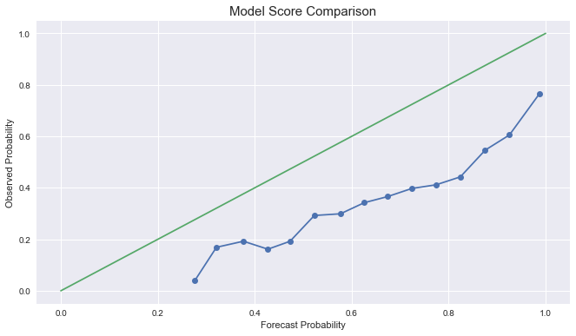
Reliability of Model Forecast Probability
Tendency to overforecast

Slide 30
Results
Results are presented in two stages:
Part A: Exclude missed detections that were not detected by both geo & polar hotspots. Not possible for ML to pick up anyway. We’ll look at this result for the purpose of model tuning & selection.
Part B: Model performance based on entire ground truth including missed detections.
Verification is done for each 2km grid & for each day (different from Himawari-8 verification earlier)

Slide 31
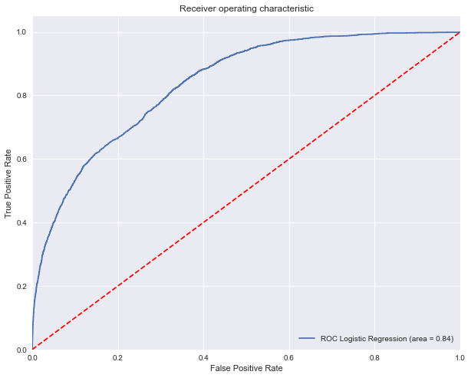
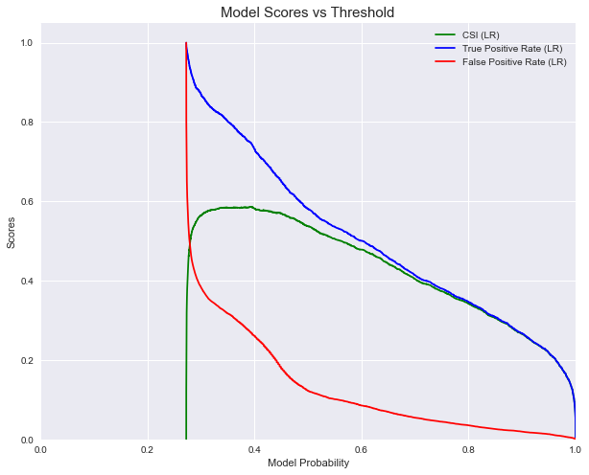
Results (Part A) for Model Selection
Best probability threshold to determine a hotspot
~38%
CSI: 0.58, Hit Rate: ~75%, FAR: 26%

Slide 32
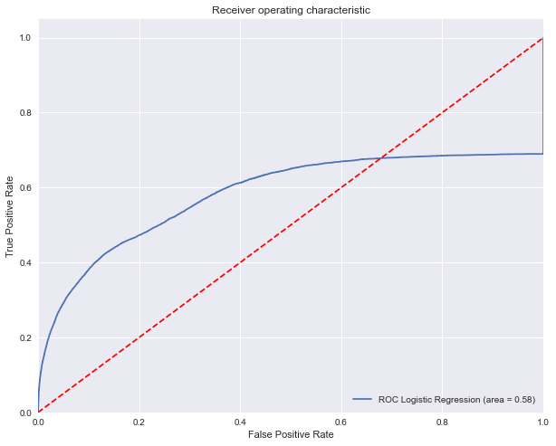
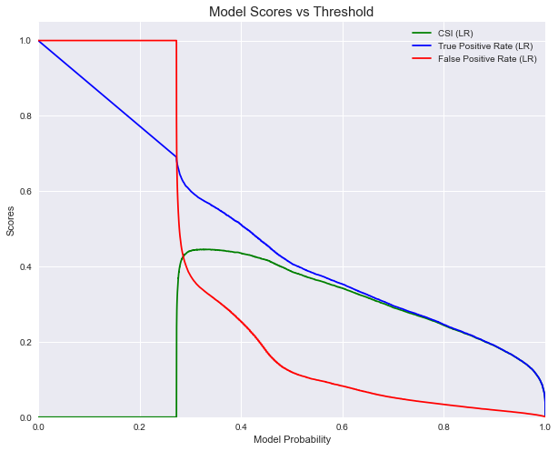
Results (Part B) Final Score
Drop in CSI and Hit Rate due to the inclusion of missed detections
CSI: 0.43, Hit Rate: 58%, FAR: 26%
Relative performance is the same as result A

Slide 33
Summary
Model calibration and tweaking completed. Will deploy the new version into operation before dry season onset.

